Slide 1
Security Operations Center
Apps

Slide 2
Types of enterprise webapp workflows
Traditional 3-Tier Architecture (Multi-Tier)
Single Page Application (SPA) Workflow
Microservices Architecture Workflow
Serverless Web Application Workflow
Monolithic Application Workflow
Event-Driven Web Application Workflow
DevSecOps CI/CD Workflow (Enterprise)
Multi-Region Global Workflow
B2B Enterprise API Workflow
Zero Trust Web Application Workflow
Hybrid Cloud Workflow
Data-Intensive Analytics Workflow

Slide 3
Traditional 3-Tier Architecture (Multi-Tier)
Level-0:
High-Level Context Flow
User browser
Presentation layer
External user
Web server
Load balancer
HTTPS Request
(Login/ Transaction/ API Call)
HTTPS Response
Web server
Application server
Business logic
Forward Request
(Internal secure channel)
Processed Response (HTML/JSON)
Response back to User
Application server
Database server
Data layer
SQL Query/ Stored procedure calls
Query Result
Database server

Slide 4
Logs Generated at Each Layer
2️⃣ Log Collection & Aggregation Workflow
[ WAF Logs ] \
[ Web Logs ] \
[ App Logs ] ---> [ Log Forwarder / Agent ]
[ DB Logs ] / |
[ OS Logs ] / v
[ Log Aggregator ]
|
v
[ SIEM ]
Enterprise Tools (Example Categories)
Log Forwarders (Agent-based collection)
Central Log Aggregator
SIEM Platform
SOAR Automation
Layer | Logs Produced
WAF | Blocked requests, attack signatures
Load Balancer | Access logs, connection logs
Web Server | HTTP access logs, error logs
Application | Auth logs, business events, exceptions
Database | Query logs, failed logins, privilege changes
OS | System logs, process events
Network | IDS/IPS alerts

Slide 5

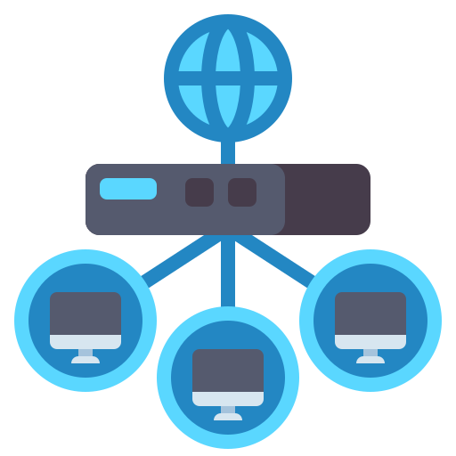
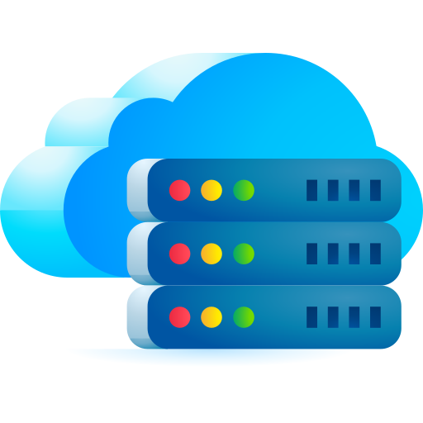
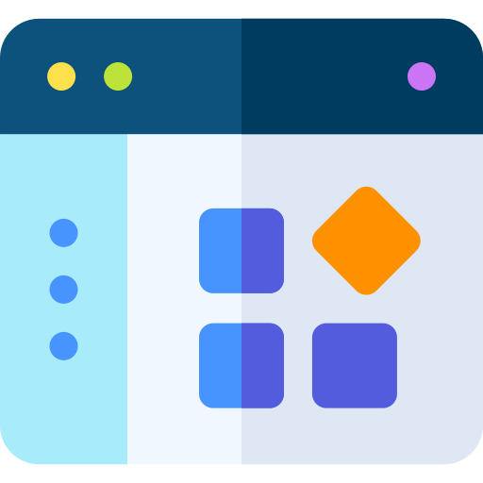
Data flow
Security Controls:
TLS Encryption
WAF filtering (SQLi, XSS, RCE protection)
Rate limiting
IP filtering
Bot protection
Level-0:
High-Level Context Flow
HTTPS Request
URL
Headers
Cookies & Session ID
Form Data / JSON Payload
Firewall / WAF
External user
HTTPS Request
(Login/ Transaction/ API Call)
HTTPS Response
Load Balancer
Session Persistence (if stateful)
Health Check Validation
Data Handling:
Terminates SSL (or passes through)
Routes traffic
Manages sessions (if sticky)
Logs request metadata
Web server
Web server (Nginx / Apache / IIS)
Forward Request
(Internal secure channel)
Processed Response (HTML/JSON)
Reverse Proxy Logic,
Static Content Handling,
Header Sanitization
Application server
Application Server
Authentication Check
Authorization Check (RBAC/ABAC)
Input Validation
Business Logic Execution
SQL Query/ Stored procedure calls
Query Result
Database server
Parameterized query/ORM call
Database Server

Slide 6
Application Tier – Business Logic Processing
[ Application Server ]
|
| 1. Authentication Check
| 2. Authorization Check (RBAC/ABAC)
| 3. Input Validation
| 4. Business Logic Execution
|
v
[ Data Access Layer ]
|
| Parameterized Query / ORM Call
v
[ Database Server ]
Internal Processes:
Request Object Creation → Controller Layer → Service Layer → Repository / DAO Layer
Security Controls:
Input validation
Output encoding
Token verification
Role validation
Audit logging
Exception handling
Data Tier – Database Processing
[ Database Server ]
| Receive SQL Query
| Validate Schema
| Execute Query
| Access Storage Engine
v
[ Data Files / Tables / Indexes ]
|
v
[ Query Result Set ]
|
v
[ Application Server ]
Data Operations:
SELECT
INSERT
UPDATE
DELETE
Stored procedures
Triggers
Security Controls:
Encryption at rest
Database firewall
Least privilege DB accounts
Activity monitoring
Replication / Backup

Slide 7
Complete End-to-End Detailed Flow
1. User enters URL or submits form
2. Browser sends HTTPS request
3. Request hits perimeter firewall
4. WAF inspects for malicious payload
5. Load balancer selects healthy web node
6. Web server receives request
7. Web server forwards to application server
8. Application server:
- Authenticates user
- Validates session/token
- Checks authorization
- Validates input
9. Business logic executes
10. Application prepares SQL query
11. Query sent over secure internal network
12. Database executes query
13. Result returned to application
14. Application processes and formats output
15. Response returned to web server
16. Web server sends HTTPS response
17. Browser renders content
✅ Logging & Monitoring Flow
Web Server Logs ---> SIEM
Application Logs ---> Log Aggregator
DB Logs ---> Monitoring System
✅ Caching Layer (Optional but common)
[ Application Server ] → [ Cache (Redis / Memcached) ] → [ Database ]
Flow:
Check cache
If hit → return data
If miss → query DB → update cache
✅ High Availability (HA Version)
+----------------------+
| Load Balancer |
+----------+-----------+
|
+------------------+------------------+
| |
[ Web/App Server 1 ] [ Web/App Server 2 ]
| |
+------------------+------------------+
|
[ Primary Database ]
|
[ Replica Database ]

Slide 8
Complete End-to-End Detailed Flow
📌 Final Enterprise Data Flow Summary
User → WAF → Load Balancer → Web Server → Application Server → Database
↑
Logging / Monitoring
↑
Security Controls
Data Flow Classification (Security View)
Data Type | Flow Path | Risk
Credentials | Browser → App | Credential theft
Session Cookie | Browser ↔ Web | Session hijacking
Business Data | App ↔ DB | SQL injection
Logs | App → SIEM | Log tampering
Secrets | App Config | Secret leakage
🔹 Where Attacks Typically Happen
Layer | Common Attacks
Browser | XSS
Web Server | Request smuggling
App Server | RCE, deserialization
Database | SQL injection
Network | MITM (if misconfigured)

Slide 9
Single Page Application (SPA) Workflow
[ User Browser ]
|
v
[ SPA Frontend (React/Angular/Vue) ]
|
v
[ REST / GraphQL API ]
|
v
[ Backend Services ]
|
v
[ Database ]
|
v
[ JSON Response ]
|
v
[ Dynamic UI Update ]

Slide 10
Microservices Architecture Workflow
[ Client ]
|
v
[ API Gateway ]
|
+----------------------+
| | |
v v v
[ Service A ] [ Service B ] [ Service C ]
| | |
v v v
[ DB A ] [ DB B ] [ DB C ]
|
+------------------------------+
|
v
[ Aggregated Response ]
|
v
[ Client ]

Slide 11
Serverless Web Application Workflow
[ User ]
|
v
[ CDN ]
|
v
[ Static Frontend Hosting ]
|
v
[ API Gateway ]
|
v
[ Serverless Function ]
|
v
[ Cloud Database ]
|
v
[ Response to User ]

Slide 12
Monolithic Application Workflow
[ Client ]
|
v
[ Monolithic Application ]
(UI + Logic + Data Access)
|
v
[ Database ]
|
v
[ Response ]

Slide 13
Event-Driven Web Application Workflow
[ User Action ]
|
v
[ Web Application ]
|
v
[ Event / Message Queue ]
|
+------------------------+
| |
v v
[ Consumer Service A ] [ Consumer Service B ]
| |
v v
[ Database ] [ Notification Service ]
|
v
[ WebSocket Update ]
|
v
[ User ]

Slide 14
DevSecOps CI/CD Workflow (Enterprise)
[ Developer Commit ]
|
v
[ Source Control (Git) ]
|
v
[ CI Pipeline Triggered ]
|
+--> SAST Scan
+--> Dependency Scan
|
v
[ Build & Containerization ]
|
+--> Container Security Scan
|
v
[ Deploy to Staging ]
|
+--> DAST / Integration Tests
|
v
[ Production Deployment ]
|
v
[ Continuous Monitoring ]

Slide 15
Multi-Region Global Workflow
[ User ]
|
v
[ Global DNS (Geo Routing) ]
|
+------------------------------+
| |
v v
[ Region A ] [ Region B ]
| |
[ Load Balancer ] [ Load Balancer ]
| |
[ App Cluster ] [ App Cluster ]
| |
[ Regional DB ] <----Replication----> [ Regional DB ]
|
v
[ Response ]

Slide 16
B2B Enterprise API Workflow
[ Partner System ]
|
v
[ Secure API Endpoint ]
|
+--> mTLS / OAuth Validation
+--> Rate Limiting
+--> Policy Enforcement
|
v
[ Backend Processing ]
|
v
[ Audit Logging ]
|
v
[ Response to Partner ]

Slide 17
Zero Trust Web Application Workflow
[ User ]
|
v
[ Identity Provider ]
|
+--> MFA Verification
+--> Device Compliance Check
+--> Conditional Access Policy
|
v
[ Policy Decision Point ]
|
v
[ Micro-Segmented Application Access ]
|
v
[ Continuous Monitoring ]

Slide 18
Hybrid Cloud Workflow
[ User ]
|
v
[ Cloud Frontend ]
|
v
[ Secure Tunnel (VPN / Private Link) ]
|
v
[ On-Prem Application ]
|
v
[ On-Prem Database ]
|
v
[ Response to User ]

Slide 19
Data-Intensive Analytics Workflow
[ User Dashboard ]
|
v
[ API Layer ]
|
v
[ Data Warehouse ]
|
v
[ Aggregation Engine ]
|
v
[ Caching Layer ]
|
v
[ Visualization Response ]

